Slide 1

Pennant Technologies Private Limited
Locks in SQL

Slide 4
Locks
A lock is a variable associated with a data item that describes the status of the item concerning possible operations that can be applied to it.
Accordingly, there is one lock for each data item in the database.
Locks are used as a means of synchronizing the access by concurrent transactions to the database item.
Locking protocols are used in database management systems as a means of concurrency control.
Many transactions may request a lock on a data item simultaneously. So, we require a mechanism to manage the locking requests made by transactions. Such a process is called Lock Manager.
It relies on the process of message passing where transactions and lock managers exchange messages to handle the locking and unlocking of data items.

Slide 5
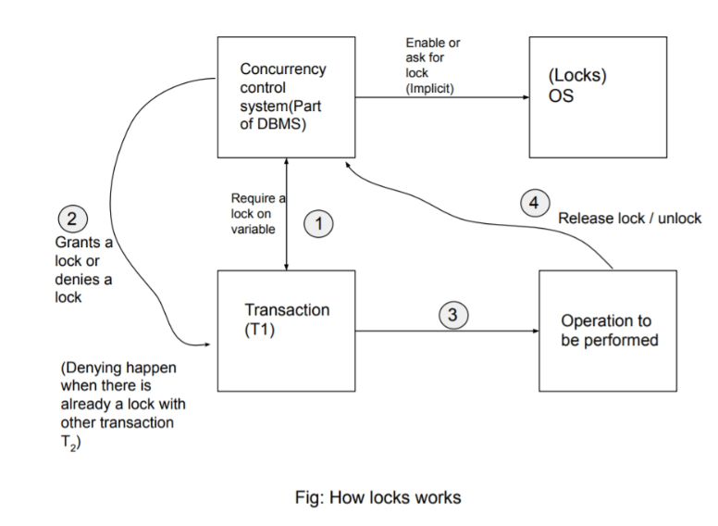
Locks
A lock is an intuitive software plus hardware functionality provided and implemented by the operating system.
A lock is a data variable linked to a specific data item.
This lock indicates that activities on the data item are permitted.
Locks in DBMS synchronize concurrent transactions' access to database elements.
The concurrency-control manager receives all lock requests.

Slide 6
What is Lock-Based Protocol?
With lock-based protocols, a transaction cannot read or write data until the proper lock is obtained. This aids in solving the concurrency issue by locking a certain transaction to a specific user. The lock is a variable that indicates which operations can be carried out on the specific data item.
Types of Locks in DBMS
There are two types of lock-based protocol in DBMS:
Shared Lock (S)
Exclusive Lock (X)
Shared Lock : A shared lock is also known as a Read-only lock. The data item can be shared between transactions via the shared lock. We will not be able to update data on the lock.
Example of shared lock: Consider the situation where two transactions read a person's account balance. By establishing a shared lock on the database, they will read it. However, a shared lock prevents another transaction from updating that account's balance until the reading procedure is completed.
Exclusive Lock: The data item can be read and written via Exclusive Lock. This exclusive mode cannot be used on the same data item simultaneously. The lock-x instruction is used to request X-lock. Transactions may unlock the data item after completing the 'write' process.
Example of exclusive lock: When a transaction needs to update a person's account balance, for example, you can allow it to proceed by putting an X lock on this transaction. As a result, the exclusive lock prevents the second transaction from reading or writing

Slide 7
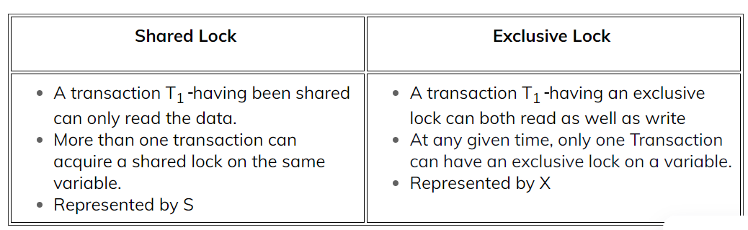

Slide 8
Types of Locks
Concurrency control protocols can be broadly divided into two categories −
Lock based protocols
Timestamp based protocol
Lock-based Protocols
Database systems equipped with lock-based protocols use a method by which any transaction cannot read or write data until it acquires an appropriate lock on it. Locks are of two varieties:
Binary Locks − A lock on a data item can be in two states; it is either locked or unlocked.
Shared/exclusive − This type of locking method differentiates the locks based on their uses. If a lock is obtained on a data item to perform a write operation, it is an exclusive lock.
Allowing more than one transaction to write on the same data item would lead the database into an incompatible state. Read locks are divided because no data value is being changed.
Several types of locks are used in concurrency control. To implement locking concepts gradually, we need to talk about binary locks, which are simple but restrictive and so are not used in practice.
After it shared/exclusive locks, which provide more general locking capabilities and are used in practical database locking schemes.

Slide 9
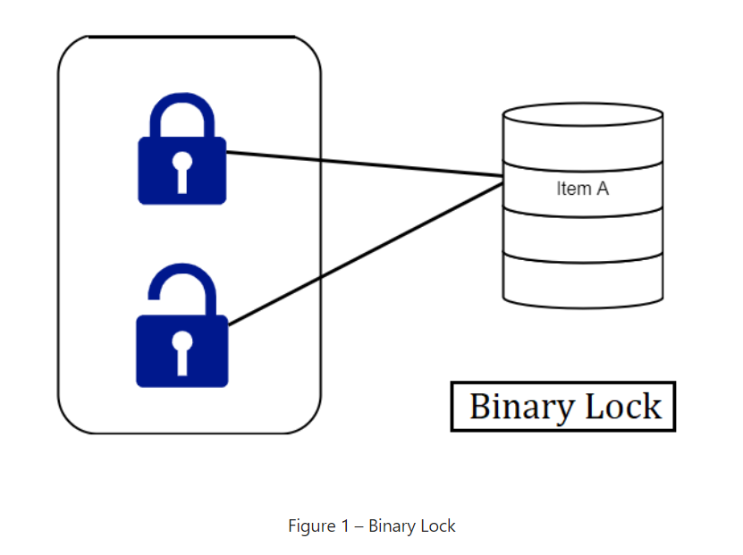
What are Binary Locks?
A binary lock can have two states or values locked and unlocked.
A distinct lock is related to each database item A. If the value of the lock on A is 1, item A cannot gain access by a database operation that requests the item.
If the lock value on A is 0 then the item can be accessed when requested. We refer to the current value of the lock associated with item A as LOCK (A).
There are two operations, lock item and unlock item are used with binary locking A transaction requests access to an item A by first issuing a locked item (A) operation. If LOCK (A) = 1, the transaction is forced to wait. If LOCK (A) = 0 it is set to 1 (the transaction locks the item) and the transaction is allowed to access item A.
When the transaction is through using the item, it issues an unlock item (A) operation, which assigns LOCK (A) to 0 (unlocks the item) so that A may be accessed by remaining transactions. Hence binary lock imposes mutual exclusion1 on the data item.

Slide 10
Rules of Binary Locks
Incase the simple binary locking scheme described here is used, every transaction must obey the following rules:
A transaction must supply the operation lock_item (A) before any read_item (A) or write, item operations are performed in T.
A transaction T must supply the operation unlock_item (A) after all read_item (A) and write_item (A) operations are completed in T.
A transaction Twill does not supply a lock _item (A) operation if it already holds the lock on Item A.
A transaction will not issue an unlock _item (A) operation unless it already holds the lock on item A.
The lock manager module of the DBMS can implement these rules. Between the Lock_item (A) and unlock_item (A) operations in transaction T, is said to hold the lock on item A.
At most one transaction can hold the lock on a particular item. Thus no two transactions can access the same item together.
Merits of Binary Locks
They are simple to execute since they are effectively mutually exclusive and establish isolation perfectly.
Binary Locks request less from the system since the system must only keep a record of the locked items. The system is the lock manager subgroup which is a feature of all DBMSs today.

Slide 11
Disadvantages of Binary Locks
As discussed earlier, the binary locking scheme is too restrictive for database items, because at most one transaction can hold a lock on a given item.
So, a binary locking system cannot be used for practical purposes.
One of the methods to ensure isolation of property in the transactions is to require data items to be accessed in a mutually exclusive manner.
That means, that while one transaction is accessing a data item, no other transaction can make changes to that data item.
So, the most common method used to implement requirements is to allow a transaction to access a data item only if it is currently holding a lock on that item.
Thus, the lock on the operation is required to ensure the isolation of the transactions.

Slide 12
How Do Shared Locks Function?
Shared locks survive when two transactions are granted read access.
One transaction gets the shared lock on data and when the second transaction requests the same data it is also given a shared lock.
Both transactions are in a read-only mode, updating the data is not allowed until the shared lock is released. There is no difference with the shared lock because nothing is being updated.
Shared locks last if they need to last; it depends on the level of the transaction that holds the lock.
Shared locks keep up read integrity. They check whether a record is not in process of being updated during a read-only request.
Shared locks can also be used to stop any kind of updates of record.
It is represented by Lock-S which is a read-only lock.
S-lock is appealed using Lock-S instruction.

Slide 13
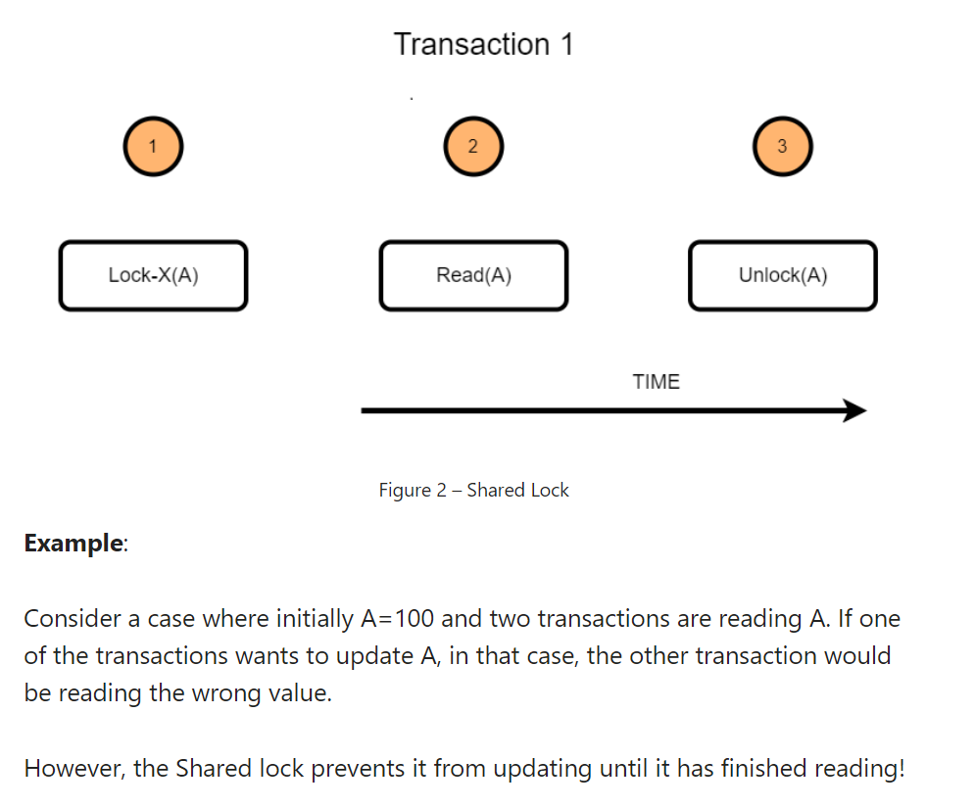

Slide 14
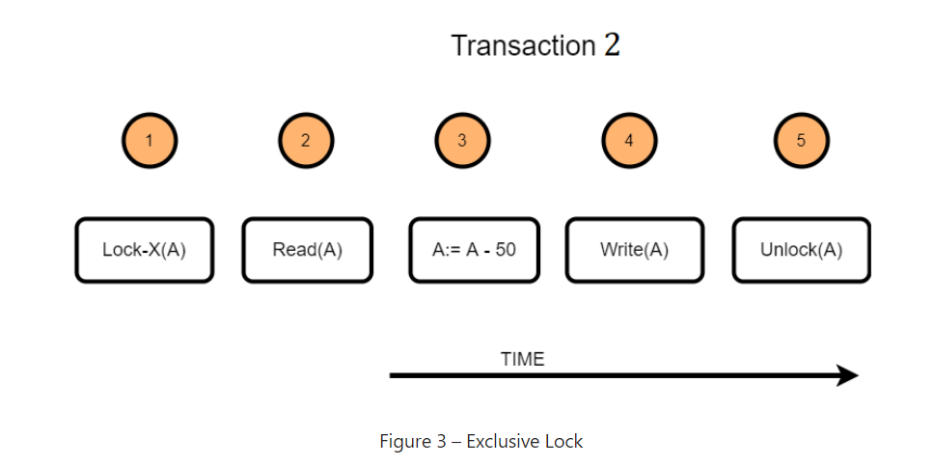
Exclusive Locks
We should allow several transactions to access the same item A if they all access A’ for reading purposes only. However, if a transaction is to write an item A, it must have total access to A.
For this purpose, a different type of lock called a multiple-mode lock is used. In this scheme, there are exclusive or read/write locks are used.
Example: Consider a transaction(T2) that requires updating the data item value A. The following steps take place when lock protocol is applied to this transaction.
T2 will acquire an exclusive lock on the data item A
Read the current value of data item A
Change the data item as required. In the example illustrated, a value of 50 is subtracted from the data item A
Write the updated value of the data item
Once the transaction is finished, the data item will be unlocked.

Slide 15
Differences between Shared Lock and Exclusive Lock
Shared Lock:
Lock mode is a read-only operation.
Shared lock can be placed on objects that do not have an exclusive lock already placed on them.
Prevents others from updating the data.
Provided when the transaction wants to read an item that does not have an exclusive lock.
Any number of transactions can hold a shared lock on an item.
S-lock is appealed using lock-S instruction.
Exclusive lock:
Lock mode is read as well as write operation.
Exclusive lock can only be placed on objects that do not have any other kind of lock.
Prevents others from reading or updating the data.
Provided when transaction wants to update unlocked item.
Exclusive lock can be observed by only one transaction.
X-lock is sought using lock-X instruction.

